Slide 1
CS385 Final Project
Michael Lang & Rachael Grabowski

Slide 2
INSTRUCTION SET
Name | Syntax | Meaning | Format | Opcode | Encoding
Add | add $d, $s, $t | $d ← $s + $t | R | 0000 | 0000 sstt dd-- ----
Subtract | sub $d, $s, $t | $d ← $s - $t | R | 0001 | 0001 sstt dd-- ----
And | and $d, $s, $t | $d ← $s & $t | R | 0010 | 0010 sstt dd-- ----
Or | or $d, $s, $t | $d ← $s | $t | R | 0011 | 0011 sstt dd-- ----
Add Immediate | addi $t, $s, C | $t ← $s + C | I | 0100 | 0100 sstt CCCC CCCC
Load word | lw $t, C($s) | $t ← DataMem[$s+C] | I | 0101 | 0101 sstt CCCC CCCC
Store word | sw $t, C($s) | DataMem[$s+C] ← $t | I | 0110 | 0110 sstt CCCC CCCC

Slide 3
INSTRUCTION SET
Name | Syntax | Meaning | Format | Opcode | Encoding
Set on less than | slt $d, $s, $t | $d = ($s < $t) | R | 0111 | 0111 sstt dd-- ----
Branch on equal | beq $s, $t, C | if ($s == $t) goto C | I | 1000 | 1000 sstt CCCC CCCC
Branch on not equal | bne $s, $t, C | if ($s != $t) goto C | I | 1001 | 1001 sstt CCCC CCCC
Shift left logical | sll $d, $t, shamt | $d ← $t << shamt | R | 1010 | 1010 --tt ddaa aa--
Shift right logical | srl $d, $t, shamt | $d ← $t >> shamt | R | 1011 | 1011 --tt ddaa aa--
Jump | j C | PC ← C | I | 1100 | 1100 ---- CCCC CCCC

Slide 4
Major Component Descriptions
Instruction Memory
The instruction memory is represented by our input.hex file (see “input.hex” below)
ALU
The ALU is a 16-bit ALU comprised of four 4-bit ALUs. It is capable of detecting overflow and zero.
Register File
Register r0 is static 0 (it cannot change or be changed). The register file is 4-word by 16-bits-per-word.

Slide 5
MAJOR COMPONENT DESCRIPTIONS
Control Unit
The mainCtrl unit takes IFID_InstrMem[15:12] as input, and outputs a control signal to the IDEX register. The control options are: RegDst, BEQ, BNE, MemToReg, MemWrite, ALUsrc, RegWrite, SLL, SRL, and ALUctl.
input.hex
The input.hex file is how we loaded our code into our program, instead of hard-coding our testing instructions. This made it very easy to swap between different sets of instructions for testing at various points in the project. MIPS ASM instructions were converted into binary, and those binary instructions were then converted into hex instructions. Those hex instructions were then read by the CPU module into instruction memory.

Slide 6
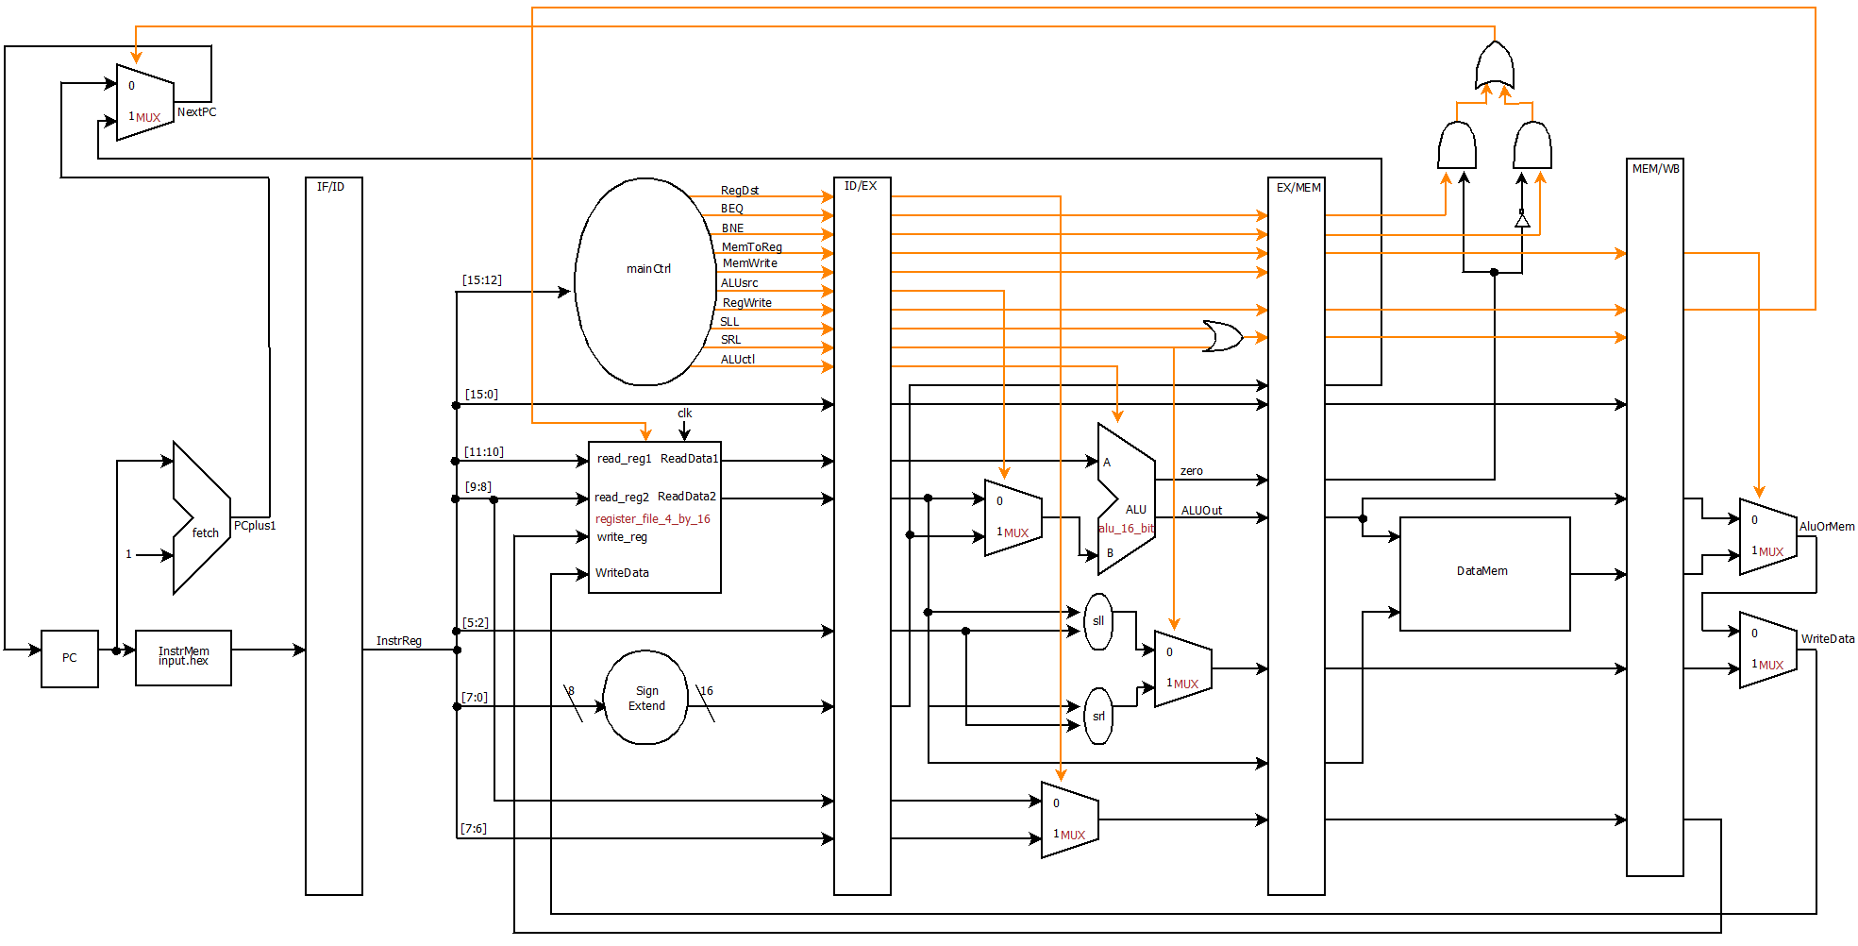

Slide 7
SLL
module shift_left_logical(out, in, shift_amount);
input [15:0] in;
input [3:0] shift_amount;
output [15:0] out;
wire [15:0] p, q, r;
mux_32_to_16 mux1(p, in[15:0], {in[7:0],8'b0}, shift_amount[3]),
mux2(q, p, {p[11:0],4'b0}, shift_amount[2]),
mux3(r, q, {q[13:0],2'b0}, shift_amount[1]),
mux4(out, r, {r[14:0],1'b0}, shift_amount[0]);
endmodule

Slide 8
Main_control
module main_control(Op,Control);
input [3:0] Op;
output reg [11:0] Control;
always @(Op) case (Op)
// {RegDst, BEQ, BNE, MemtoReg, MemWrite, ALUSrc, RegWrite, SLL, SRL, ALUctl[2], ALUctl[1], ALUctl[0]}
4'b0000: Control <= 12'b100000100010; // add
4'b0001: Control <= 12'b100000100110; // sub
4'b0010: Control <= 12'b100000100000; // and
4'b0011: Control <= 12'b100000100001; // or
4'b0100: Control <= 12'b000001100010; // addi
4'b0101: Control <= 12'b000111100010; // lw
4'b0110: Control <= 12'b000011000010; // sw
4'b0111: Control <= 12'b100000100111; // slt
4'b1000: Control <= 12'b010000000110; // beq
4'b1001: Control <= 12'b001000000110; // bne
4'b1010: Control <= 12'b100000110000; // sll
4'b1011: Control <= 12'b100000101000; // srl
4'b1100: Control <= 12'b011000000110; // j
endcase
endmodule

Slide 9
Test Program
Input.hex – a 40 instruction peasant multiplication algorithm (including nops) that demonstrates the usability of our mini MIPS machine. It utilizes lw, sw, addi, beq, sq, addi, and, add, sll, srl, and j instructions. The code snippet on the following slide does not contain nops, to demonstrate more of the actual logic.

Slide 10
Code snippet
5100 // lw $1, 0($0) ==> 0101 0001 0000 0000 // $1 <- x
5201 // lw $2, 1($0) ==> 0101 0010 0000 0001 // $2 <- y
4300 // addi $3, $0, 0 ==> 0100 0011 0000 0000 // $3 <- 0
8827 // beq $2, $0, 39 ==> 1000 1000 0010 0111 // if y == 0 goto 39
6302 // sw $3, 2($0) ==> 0110 0011 0000 0010 // a <- $3
4301 // addi $3, $0, 1 ==> 0100 0011 0000 0001 // $3 <- 1
2bc0 // and $3, $2, $3 ==> 0010 1011 1100 0000 // $3 <- y && 1
8c1e // beq $3, $0, 30 ==> 1000 1100 0001 1110 // if $3 == 0 goto 30
5302 // lw $3, 2($0) ==> 0101 0011 0000 0010 // $3 <- a
0dc0 // add $3, $3, $1 ==> 0000 1101 1100 0000 // $3 <- a + x
a144 // sll $1, $1, 1 ==> 1010 0001 0100 0100 // x *= 2
b286 // srl $2, $2, 1 ==> 1011 0010 1000 0100 // y //= 2
c005 // j 5 ==> 1100 0000 0000 0101 // goto 5

Slide 11
